Slide 1


Sports Analytics: Sports is Big Business Module 1
Dr. Dave Schrader
Teaching Module For Teradata University Network
Send Questions or Comments to drdaveschrader@gmail.com

Slide 2
ORGANIZATION of the MODULES
There are two versions of the materials
You can read the “Overview Deck” which has all the slides in one place
Or – you can access 6 modules that carve the material up
#1 – Sports is Big Business
#2 – Sports Analytics is HOT
#3 – Sports Analytics for Business Operations
#4 – Sports Analytics for Team Operations
#5 – Sports Analytics for Training, Health, and Safety
#6 – How to Get a Job in Sports Analytics

Slide 3
AMERICAN ACRONYMs CHEAT SHEET
ESPN – an Sports Broadcast Network
MLB – Major League Baseball
MLS – Major League Soccer
NBA – National Basketball Association
NCAA – National Collegiate Athletic Association
NFL – National Football League
NHL – National Hockey League
Notes:
Acronyms in case you do not know the American leagues for various sports, or the major TV channel devoted to sports “Entertainment and Sports Network” ESPN

Slide 4
6 Key Topics
Sport is Big Business ($$$)
The field of Sports Analytics is hot
Sports Analytics apply to Business Operations
Sports Analytics apply to Team Operations (new opportunities from video and sensor data)
Analytics are also used across all sports for training, health and safety
Tips on getting a job in sports analytics
Notes:
is an overview of the flow of the topics across the various modules. You will need to read the other Modules and Teaching Notes before you present this.

Slide 5
Overview: Sport is Big Business Topic 1
How much Revenue?
Price Waterhouse Cooper predicts
$145B revenue WW in 2015
$66.3B in North America
Sources
Worldwide: http://www.pwc.com/gx/en/hospitality-leisure/changing-the-game-outlook-for-the-global-sports-market-to-2015.jhtml
North America: http://www.pwc.com/gx/en/sports-mega-events/news/sports-outlook-north-america-2014.jhtml
Notes:
Teaching Notes for Sports Analytics
Module 1 – Sport is Big Business (PowerPoint)
Provided by Dr. Dave Schrader, drdaveschrader@gmail.com
Motivation: The purpose of this module is to provide students a quick synopsis of the size of the market for sports. As part of the entertainment/leisure category, sport dollars include money from tickets, merchandise sales, sponsorships, and of course, television and radio. A second goal other than setting a foundation is to educate students that in many ways, sport is no different from any other industry. Decisions are constantly being made that can impact a team’s revenues, and analytics is fairly new tool for most of these team
This module covers a variety of sports, including international ones (although the bias for American sports will be crystal-clear). The educational goals for this module include:
Students should be aware of the size of the sports market
They should become aware of the various components of revenue sources
Depending on interest, they should be able to go find additional revenue information about their favorite sport or team
There are various estimates of the industry revenues depending on what revenue sources you count. Don’t’ get hung up on this - – some other estimate may differ. The key point is that there is a lot of money in sport, a sliver of which will go towards analytics.

Slide 6
Sport is Business
Each team has employees (coaches, players, managers, trainers), sells a product, has revenues and expenses, even pays some taxes.
Sports Leagues (such as the Premier League and the NFL) are BIG Businesses with revenues in the billions of dollars.
Individual sports teams (such as Manchester United and the Seattle Seahawks) are small to medium size businesses with revenues in the tens to hundreds of millions of dollars.
Just like when running any other business, better decisions can be made by using data and analytics
Notes:
This page elaborates on the various aspects of sports revenues, and provides some relative sizings of the revenue numbers.

Slide 7
Sport is Big Business – Pros in the USA
Which American Pro Sports generate the most revenue?
MLB $8B $237M/baseball team
NFL $6B $286M/football team
NBA $4.8B $152M/basketball team
NHL $3.7B $88M/hockey team
MLS $362M $19M/soccer team
But is this is too USA-Centric? YES!
QUIZ
Source; http://www.foxsports.com/buzzer/story/which-pro-sport-generates-the-most-revenue-051414
Notes:
these numbers break out information by pro American sport. A key point at the end is that MLS is small compared to international soccer leagues (next page). You can ask students which is the highest value worldwide.

Slide 8


International Soccer Revenues
$4.4B Premier League
$2.0B Bundesliga (Germany)
$1.9B La Lega (Spain)
$1.7B Serie A (Italy)
$1.3B Ligue 1 (France)
$900M Campeonato (Brazil)
And on and on
Source: Leaguehttps://en.wikipedia.org/wiki/List_of_professional_sports_leagues_by_revenue /
Notes:
here are the numbers for the top Soccer (“Football” outside the USA) leagues – they stack up quite favorably against American pro leagues

Slide 9

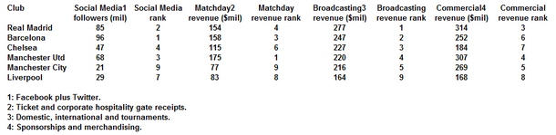
Soccer Revenues Are Huge
The 20 most valuable soccer teams in the world are worth an average of $1.16 billion, 11% more than last year, 84% higher than 5 years ago.
Real Madrid is the most valuable team, worth $3.26 billion, mainly due to $746 million in revenue, the most of any sports team.
Source; http://www.forbes.com/sites/mikeozanian/2015/05/06/real-madrid-tops-ranking-of-the-worlds-most-valuable-soccer-teams/

Slide 10
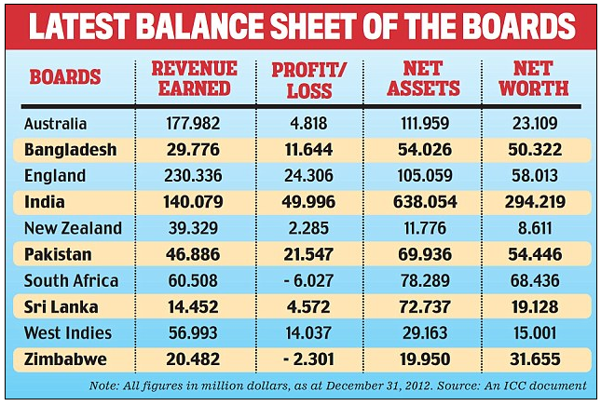
Cricket Has Big Revenues, Too!
Huge revenue sport in England, India and the Commonwealth countries
Source; http://www.dailymail.co.uk/indiahome/indianews/article-2338491/Scandal-hit-BCCI-makes-highest-profit-Test-playing-countries.html
Notes:
in an early test version of this, the Indian students wanted to know about cricket, so I added this page. The tallies are by league (so you can compare, for example, the British Cricket League to MLS). Most Americans have no idea that cricket is this big!

Slide 11
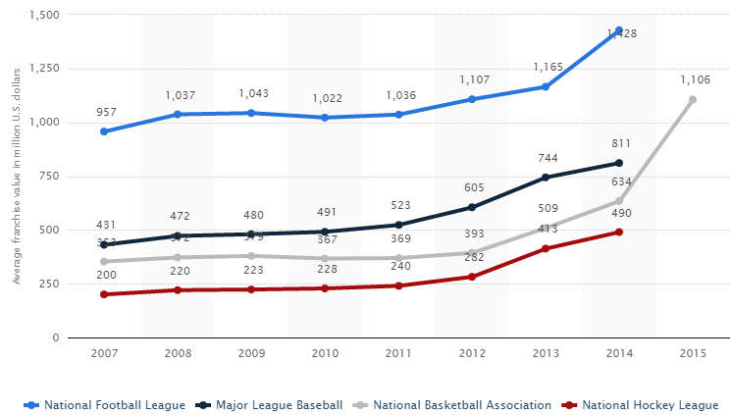
USA Sport is Big Business – Avg Pro Franchise Value
NFL - $1.4B
NBA - $1.1B
MLB - $834M
NHL - $490M
Source: http://www.statista.com/statistics/202758/franchise-value-of-us-sports-teams/
Notes:
team values are going up (You can ask: “Why did the NBA line accelerate?” Answer: Steve Ballmer buying an NBA team for $2B last year helped that NBA average go up considerably)

Slide 12
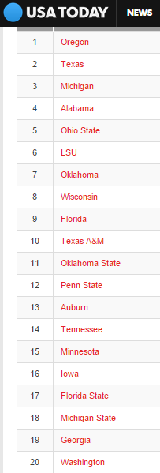

Sport is Big Business for USA Colleges
20 schools* generate more than $100M/year in revenues
College Football $3.4B
ESPN 12 year contract at $5.6B to broadcast playoffs and 6 bowls ($470M/year)
College Basketball $1.4B (est.)
$10.8B 14 year contract with CBS Sports/Turner
NCAA generated $918M (2013)
* Private schools like USC and Stanford not included
Source; http://sports.usatoday.com/ncaa/finances/
Source: : http://www.businessinsider.com/college-football-revenue-2014-12 /
Notes:
A key point is that anything that is happening at the Pro level will be driven down into the university sports teams. Out of the Sports budgets at most schools, American football is the big revenue producer (basketball is in 2nd place). NCAA revenues for schools come from TV revenue, although there is a new trend for local conferences (like the Big 10 and SEC conferences) to start creating their own TV networks.

Slide 13
Sport is Big Business
Just like when running any other business, better decisions can be made by using data and analytics – and that’s the focus of the rest of this presentation
Most pro teams split the organization into two groups
Business Operations
Team Operations
We’ll use this differentiation to organize later modules, but call out Health/Safety/Training as a separate topic because that crosses all sports.
Notes:
Summary slide. This sets up a couple of points that will help with the segue to Module 2, where we drill down into details of the various uses of data to make better decisions. Two good open-ended questions for discussion to close out this module would be:
Can anyone think of examples where data collection and analysis could help a team or player make better decisions?
Are there analogies between the world of business and the world of sports? What can sports teams learn from business uses of data and analytics? What can business people learn from sports team’s uses of data and analytics?
If you are teaching in an area with some teams, you might want to augment the materials here with more details about the local team, or give students a homework assignment to go research online data about the local team(s).

